Slide 1


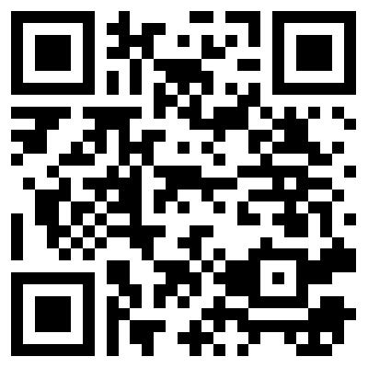
Blockchain and Disruptive Technologies: Preparing for the Not-So-Distant Future
Professor Subodha Kumar

Slide 2
Blockchain and Disruptive Technologies
Blockchain
FinTech
Chatbots
Autonomous Vehicles
Artificial Intelligence/Machine Learning/Deep Learning/Internet of Things (IoT)
Industry 4.0
Notes:
Some SCM related companies
Retailers: 7-Eleven, Wal-Mart, Amazon, Borders
Distributors: McMaster-Carr, W.W. Grainger; Alliance, Maclean
Manufacturers: Dell Direct; HP/Compaq: direct and store; Gateway: phys. Direct.
Logistics Service Providers: Schneider, Ryder logistics
SCM software: SAP, i2, Manugistics
What are some supply chain related decisions that any of the above firms faces (5-10 minutes)? What should a SC Manager worry about? What questions should be answered?
Organize answers in rows for of strategic/design, planning, operation and in columns for the four drivers: facilities, inventory, transportation, information, + customer needs. Maybe use overhead, set aside for later reference.

Slide 3
Data Analytics and Decision Analytics
Business Analytics
Data Analytics
Decision Analytics
Collecting raw data
Data cleansing
Data analytics models
Convert data analytics into valuable business decisions
Analytical and Optimization Models
Machine Learning, Artificial Intelligence, Deep Learning, etc.
Exploratory Data Analysis (EDA)
Confirmatory Data Analysis (CDA)
Qualitative Data Analysis (QDA)

Slide 4

What is Blockchain ?
A Blockchain is a historical record of transactions, much like a database
Blocks in a chain = pages in a book. Each page in a book contains:
The text: the story
Each page has information about itself: title of the book, chapter title, page number, etc. (e.g. the “metadata”)

Slide 5
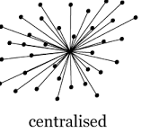
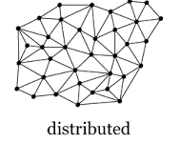
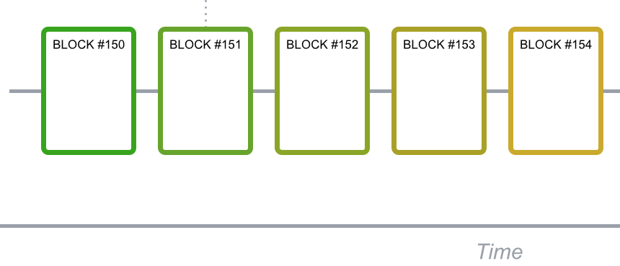
What is a Blockchain?
Core premise
Vs.
Data is stored in a distributed manner (Each point is called a node)
Blocks
Every transaction is added to a block which is appended to each node

Slide 6
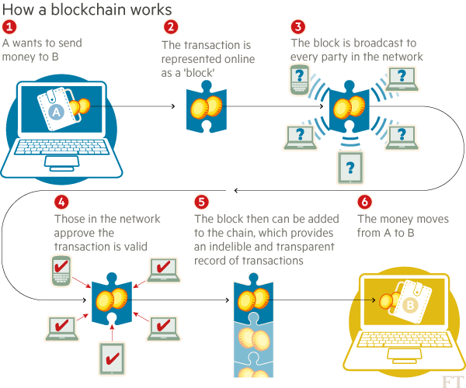
Blockchain

Slide 7
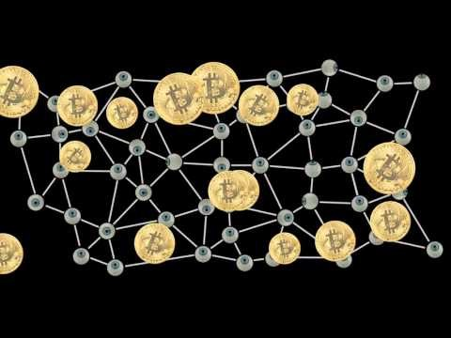
Blockchain

Slide 8
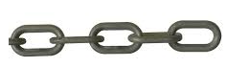
Why is blockchain so secure?
NODE 1
NODE 2
Each node has the same data chain (Block chain)
NODE 3
NODE 4
New data can be added to the blockchain only when there is consensus between all nodes
(RISK OF DATA CONSISTENCY MANAGED)
Data cannot be accessed without a key which is given by the data owner
(RISK OF UNAUTHORIZED DATA ACCESS MANAGED)

Slide 9

Constructs of A Blockchain?
Each block has a
A header
Contains data about the block
A digital fingerprint (aka “hash”)
Important for ordering and block validation.

Slide 10
Basic Principles of Blockchain Technology
Distributed Database
Each party on a blockchain has access to the entire database and its complete history.
No single party controls the data or the information.
Every party can verify the records of its transaction partners directly, without an intermediary.

Slide 11
Basic Principles of Blockchain Technology
Peer-to-Peer Transmission
Communication occurs directly between peers instead of through a central node.
Each node stores and forwards information to all other nodes.

Slide 12
Basic Principles of Blockchain Technology
Transparency with Pseudonymity
Every transaction and its associated value are visible to anyone with access to the system.
Each node, or user, on a blockchain has a unique 30-plus-character alphanumeric address that identifies it.
Users can choose to remain anonymous or provide proof of their identity to others.
Transactions occur between blockchain addresses.

Slide 13
Basic Principles of Blockchain Technology
Irreversibility of Records
Once a transaction is entered in the database and the accounts are updated, the records cannot be altered, because they're linked to every transaction record that came before them (hence the term "chain").
Various computational algorithms and approaches are deployed to ensure that the recording on the database is permanent, chronologically ordered, and available to all others on the network.

Slide 14
Basic Principles of Blockchain Technology
Computational Logic
The digital nature of the ledger means that blockchain transactions can be tied to computational logic and in essence programmed.
So users can set up algorithms and rules that automatically trigger transactions between nodes.

Slide 15
History of Blockchain
The first major blockchain innovation was bitcoin, a digital currency experiment.
The market cap of bitcoin now hovers between $10-$20 billion dollars, and is used by millions of people for payments, including a large and growing remittances market.

Slide 16
History of Blockchain
2. The second innovation was called blockchain
Realization that the underlying technology that operated bitcoin could be separated from the currency and used for all kinds of other interorganizational cooperation.
Almost every major financial institution in the world is doing blockchain research at the moment, and 15% of banks are estimated to be using blockchain in 2017.

Slide 17
History of Blockchain
The third innovation was called the smart contract
Embodied in a second-generation blockchain system called ethereum
The ethereum smart contract platform now has a market cap of around a billion dollars, with hundreds of projects headed toward the market.

Slide 18
Smart Contracts
In 1994, Nick Szabo, a legal scholar, and cryptographer, realized that the decentralized ledger could be used for smart contracts.
Also called self-executing contracts.
In this format, contracts could be converted to computer code, stored and replicated on the system and supervised by the network of computers that run the blockchain.
This would also result in ledger feedback such as transferring money and receiving the product or service.
Smart contracts help you exchange money, property, shares, or anything of value in a transparent, conflict-free way while avoiding the services of a middleman.
The best way to describe smart contracts is to compare the technology to a vending machine.
Ordinarily, you would go to a lawyer or a notary, pay them, and wait while you get the document.
With smart contracts, you simply drop a bitcoin into the vending machine (i.e., ledger), and your escrow, driver’s license, or whatever drops into your account.
More so, smart contracts not only define the rules and penalties around an agreement in the same way that a traditional contract does, but also automatically enforce those obligations.
In 2015, the Depository Trust & Clearing Corp. (DTCC) used a blockchain ledger to process more than $1.5 quadrillion worth of securities, representing 345 million transactions.

Slide 19
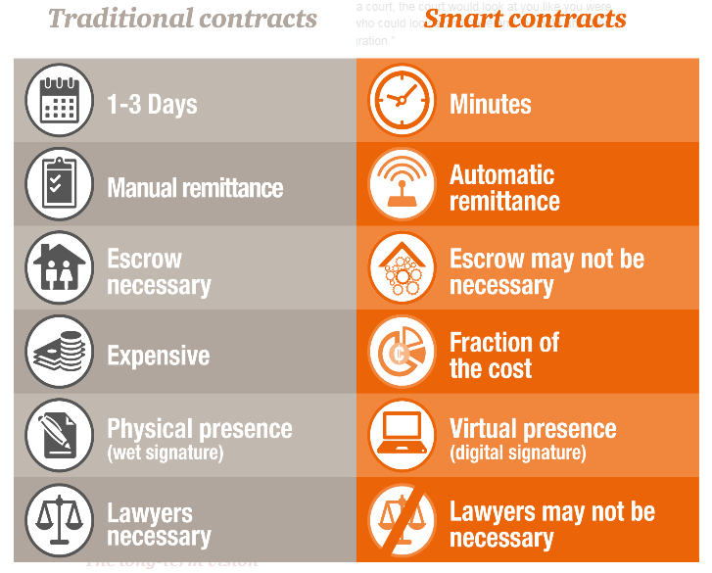
What is a Smart Contract ?

Slide 20
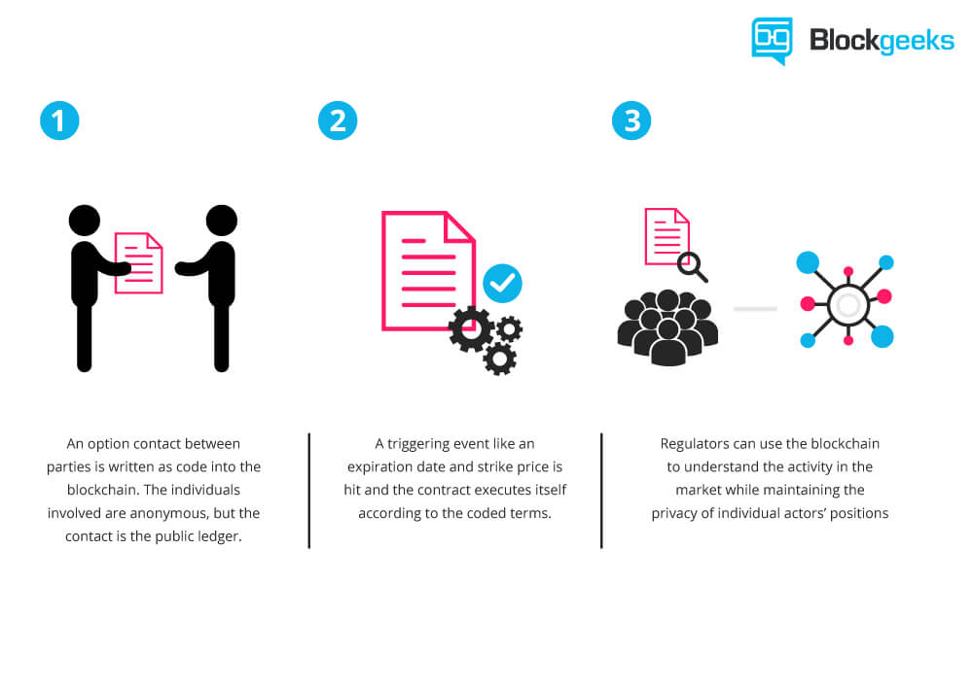
Smart Contracts

Slide 21
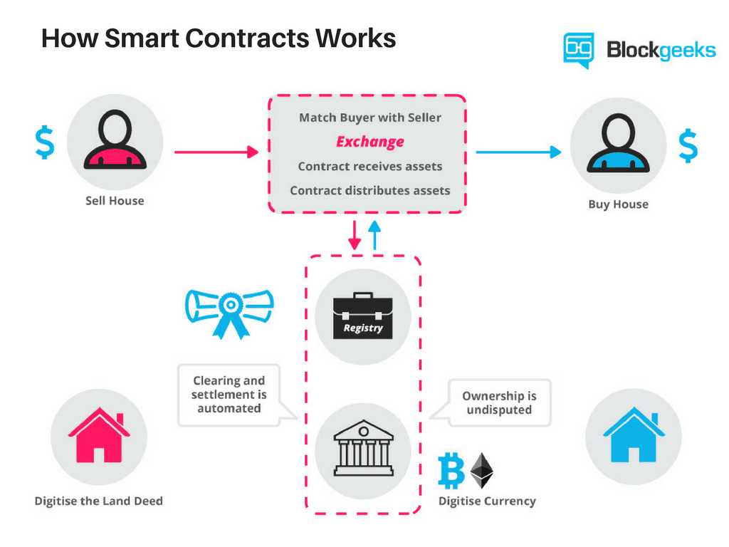

Slide 22
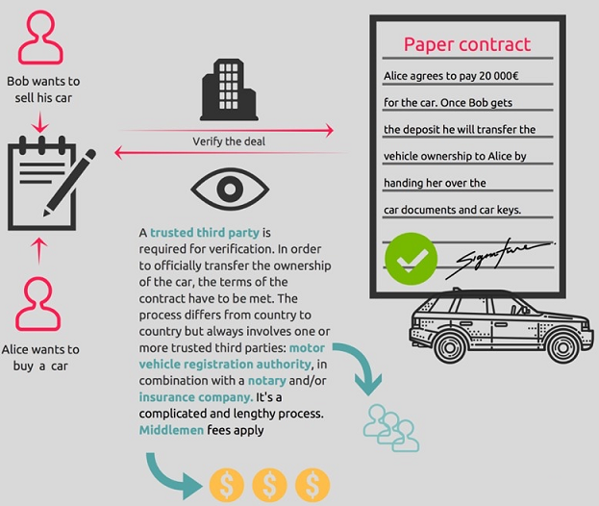
Traditional Contract : An overview
If Bob and Alice don’t know and don’t trust each other, they usually need a trusted third party to serve as an intermediary to verify transactions and enforce them.

Slide 23
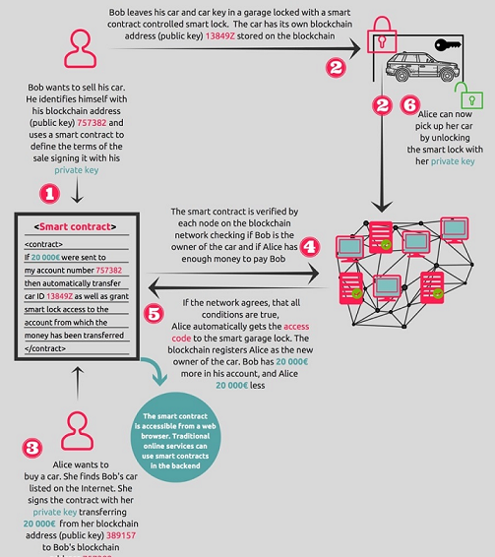
What changes with Blockchain (Smart Contract)
On the Blockchain, a smart contract could be used to define all the rules of a valid care sale. If Alice wanted to buy the car from Bob using a smart contract on the Blockchain, the transaction would be verified by each node in the Blockchain Network to see if Bob is the owner of the car and if Alice has enough money to pay Bob

Slide 24

Smart Contracts

Slide 25
Problems with Smart Contracts
Smart contracts are far from perfect.
What if bugs get in the code?
Or how should governments regulate such contracts?
Or, how would governments tax these smart contract transactions?
What happens if I send the wrong code,
or, I send the right code, but my apartment is condemned (i.e., taken for public use without my consent) before the rental date arrives?
If this were the traditional contract, I could rescind it in court, but the blockchain is a different situation. The contract performs, no matter what.
The list of challenges goes on and on.
Experts are trying to unravel them, but these critical issues do dissuade potential adopters from signing on.

Slide 26
History of Blockchain
The fourth major innovation, the current cutting edge of blockchain thinking, is called the proof of stake.
Current generation blockchains are secured by "proof of work," in which the group with the largest total computing power makes the decisions.
These groups are called "miners" and operate vast data centers to provide this security, in exchange for cryptocurrency payments.
The new systems do away with these data centers, replacing them with complex financial instruments, for a similar or even higher degree of security.

Slide 27
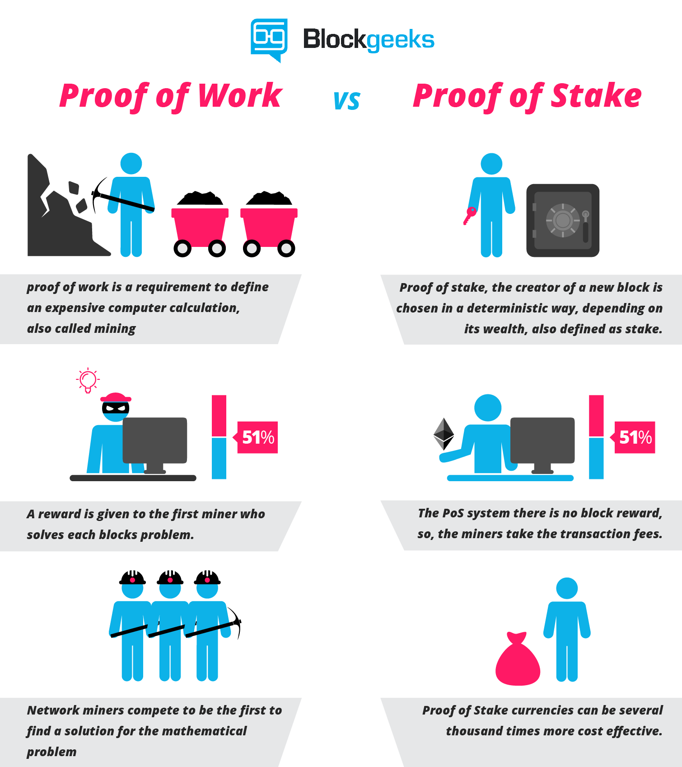

Slide 29
History of Blockchain
5. The fifth major innovation on the horizon is called
blockchain scaling.
Right now, in the blockchain world, every computer in the network processes every transaction.
This is slow.
A scaled blockchain accelerates the process, without sacrificing security, by figuring out how many computers are necessary to validate each transaction and dividing up the work efficiently.
To manage this without compromising the legendary security and robustness of blockchain is a difficult problem, but not an intractable one.
A scaled blockchain is expected to be fast enough to power the internet of things and go head-to-head with the major payment middlemen (VISA and SWIFT) of the banking.

Slide 31
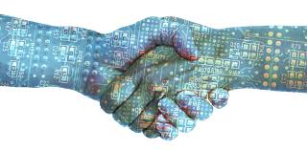
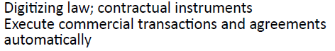
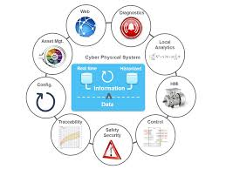
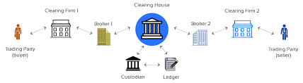
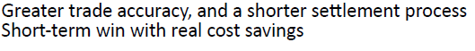
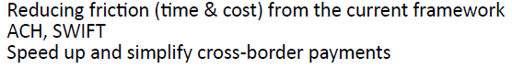
Applications of Blockchain
Digital Identity
Smart Contracts
Clearing and Settlement
Smart Assets

Slide 32
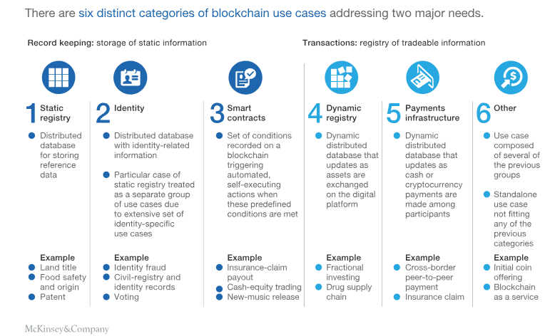
Applications of Blockchain

Slide 33
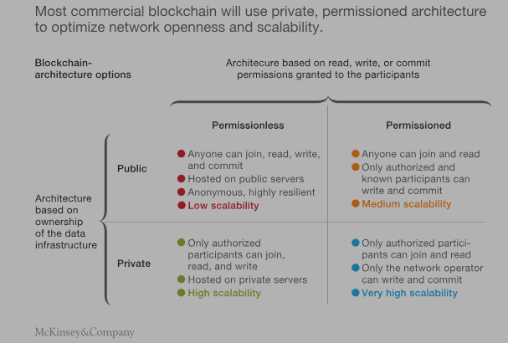
Applications of Blockchain

Slide 34
How Blockchain will Change Businesses and Organizations
Human Resources and Procurement
Will enable organizations requiring specialized talent and capabilities to ob­tain better information about potential contractors and partners than many traditional recruitment and procurement methods offer.
With a prospective employee's consent, an employer will have access to a cache of information that's known to be correct because it has been uploaded, stored, and managed on a highly secure, distributable database.
For example, job prospects wouldn't be able to lie about their training or degrees because an authority, such as the university they graduated from, has entered the data on the blockchain.
Tampering with data after the fact wouldn't be possible: It would involve taking over the entire blockchain, a nearly impossible task.

Slide 35
How Blockchain will Change Businesses and Organizations
2. Finance and Accounting
When you search the web for a company's financial data, you search in two dimensions: horizontal (across the web) and vertical (within particular websites).
On a blockchain, though, there's a third dimension: sequence.
In addition to being able to obtain a historical picture of the company since it was incorporated, you can see what has occurred in the last few minutes.

Slide 36
How Blockchain will Change Businesses and Organizations
3. Sales and Marketing
Just as a blockchain provides a way to ob­tain information about potential contractors and partners, it will be able to tell you about people or businesses who are potential customers.
Blockchain will allow companies to engage with individual customers on a peer-to-peer basis. This may seem like a lot of effort, but it could actually be a huge opportunity.

Slide 37
How Blockchain will Change Businesses and Organizations
4. Legal Affairs
Corporations are vehicles for creating long-term contracts when short-term contracts require too much effort to negotiate and enforce.
Blockchains facilitate contracting in both the short and long term.
Through smart contracts - software that, in effect, mimics the logic of contracts with guaranteed exe­cution, enforcement, and payments - companies will be able to automate the terms of agreement.
Because the contracts will be self-enforcing, corporations will not want to enter into them lightly.

Slide 38
How Blockchain will Change Businesses and Organizations
5. Raising Capital
Blockchain has the potential to disrupt the way the global financial system works and change the nature of investment.
Mindful of this prospect, the New York Stock Exchange has invested in Coinbase Inc., a digital currency wallet and platform company headquartered in San Francisco, California.
For its part, the Nasdaq Stock Market is also experimenting with blockchain technology.

Slide 39

How Blockchain will Change Businesses and Organizations

Slide 40
A Framework for Blockchain Adoption

Slide 41
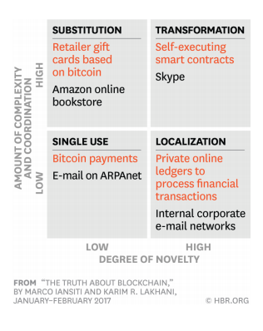
Parallels Between Blockchain and TCP/IP

Slide 42
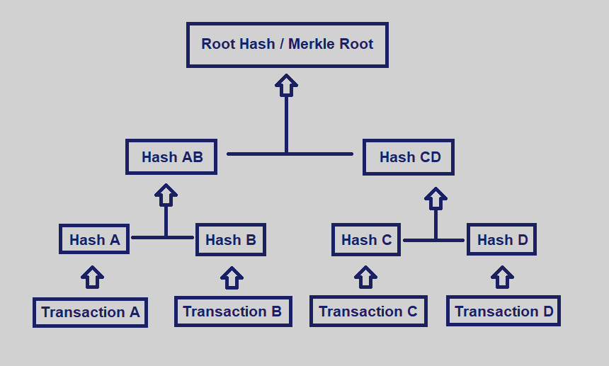
Merkle Trees

Slide 43
Merkle Root
Summarizes all of the data in the related transactions, and is stored in the block header.
Maintains the integrity of the data.
If a single detail in any of the transactions or the order of the transactions changes, so does the Merkle Root.

Slide 44
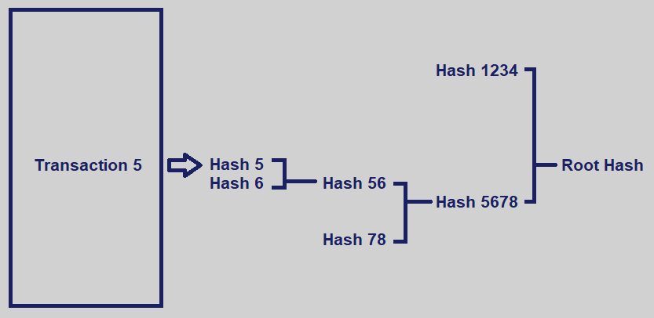
Merkle Root
Allows for a quick and simple test of whether a specific transaction is included in the set or not.
The entire dataset doesn’t need to be downloaded to verify the integrity of Transaction 5.

Slide 45
Advantages of Merkle Tree
A Merkle tree differs from a hash-list in that
with a Merkle tree, one branch can be downloaded at a time and the integrity of each branch can be immediately verified, even if the rest of the tree is not yet available.
Three major benefits:
Provide a means to prove the integrity and validity of data
Require little memory or disk space as the proofs are computationally easy and fast
Proofs and management only require tiny amounts of information to be transmitted across networks

Slide 46
Uses of Merkle Tree in Blockchains
The ability to prove that a log is complete and consistent is essential to blockchain technology and the general ledger concept.
Merkle trees help verify that later versions of a log include everything from an earlier version and that all data is recorded and presented in chronological order.
Proving that a log is consistent requires showing that no previous records have been added, altered or tampered with, and that the log has never been branched or forked.
Merkle trees benefit miners and users on the blockchain.
A miner can calculate hashes progressively, as the miner receives transactions from peers.
A user can verify parts of blocks individually and can check individual transactions using hashes of other branches of the tree.

Slide 47
Uses of Merkle Tree in Blockchains
Ethereum uses three different Merkle Roots in each block:
The first root is of the transactions in the block
The second root represents the state
The third root is for transaction receipts
Ethereum uses a special type of hash tree called the ‘Merkle Patricia Tree’
https://github.com/ethereum/wiki/wiki/Patricia-Tree
Merkle trees are powerful and indispensable tools for miners and users on the blockchain.
They are extremely robust and are at the heart of several p2p networks such as BitTorrent, Git, Bitcoin, and Ethereum.

Slide 48
Blockchain Demos
https://blockchaindemo.io/
https://demoblockchain.org/hash
https://andersbrownworth.com/blockchain/public-private-keys/keys
https://www.blockchain.com/
https://www.coinbase.com/
https://www.blockchain.org
https://www.ethereum.org
https://developers.ripple.com/

Slide 49
Financial Technology (FinTech)
Internet companies that streamline financial systems and make funding the supply chain more efficient.
New enterprises as Orbian, Prime Revenue, C2FO, Taulia, and Ariba
New operations launched by traditional financial service firms as Citi Group, HSBC, BNP Paribas, and Deutsche Bank
Provide an integrated solution that supports a process that begins with a purchase requisition and terminates with payment to suppliers.

Slide 50
FinTech Ecosystem

Slide 51
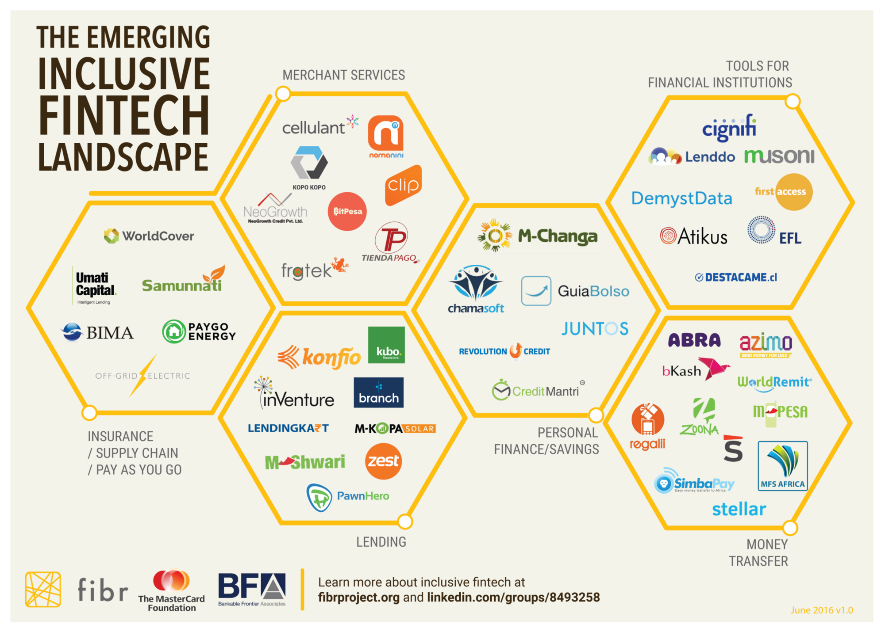
Financial Technology (FinTech)

Slide 52
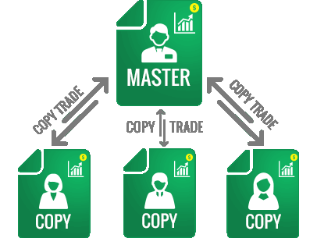
Social Trading
Connects all the traders and trade followers
In the same way Facebook and Twitter connect friends and family.
Initial trading networks were very much based around information sharing
New networks very much focus around the “social” and “automated trading” aspects
Not only allow you to view, analyze and comment on the performance of real live traders, but …
they also allow you to automatically copy the trades in your account from the traders you decide to follow.

Slide 53
Social Trading: Can I Make Money?
It is a known fact that only a small number of traders are consistently successful
Social trading networks allow you to try to find them and directly invest your money like they do.
Since the traders you can copy can both buy or sell positions (e.g. of a Forex currency pair), they can make money both when a price goes up or down.
Your performance is therefore not dependent on the overall market direction, but only on the way the traders you copy perform.
If you’re a trader yourself, the social trading networks give you access to an additional revenue stream by sharing your trades on the network.
The better you trade, the more people will copy you and the more extra money you make.

Slide 54
Top 10 Best Social Trading Networks 2019
1. eToro: One of the first ones started in 2010
2. ZuluTrade
3. Naga Trader (former SwipeStox)
4. Tradeo
5. Darwinex
6. Ayondo
7. FX Junction
8. Myfxbook Autotrade
9. MyDigiTrade
10. Tradency Mirror Trader

Slide 55
Crowdfunding
Raising money through the collective effort of family, friends, individual investors and customers.
Taps into the collective efforts of many people—primarily online through crowdfunding and social media platforms.
In 2017, over $34 billion was raised by crowdfunding.

Slide 56
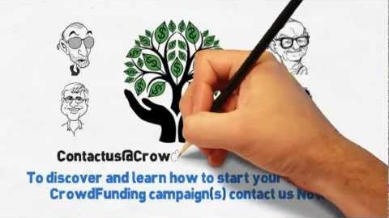
Crowdfunding

Slide 57
FinTech Crowdfunding Sites
8 best FinTech crowdfunding sites for new creative projects
Kickstarter
Indiegogo
Patreon
Crowdfunder (Shopify App)
GoFundMe
Fundable
Crowdcube
Crowdfunder

Slide 58
FinTech in Microfinance
While the citizens of Norway, Finland, and Denmark all have at least one bank account,
there are developing countries like the Central African Republic, Niger, and Madagascar, where the percentage of the unbanked population rises well above 85%.
The poverty rates in such places are quite high, and is part of a vicious circle, since the inability to get a loan or to make deposits keeps people living day to day.
The only available financial resource is social borrowing from friends and family.
Yet, rapid technological advancements could turn this situation around.

Slide 59
The World of Micro-Loans
The regions with unbanked population have attracted a different type of financial services.
Micro-financial institutions (MFIs) have developed a particular product, the microcredit, as a way to grant individuals the necessary money to expand a small business or to cover some surging costs, like healthcare.
Yet, the current model for these products is far from efficient, with high operational fees that translate to interest rates around 35-40%.
It has even been said that micro-loans promote poverty.
From the lender’s perspective, the product carries a high risk since until now, there were no tools to assess the creditworthiness of the borrower.
Is there a better solution for this problem?

Slide 60
FinTech in Microfinance: Operational costs
Since most of these companies operated in rural communities, they relied on a personal banking model, where an agent would sell the service after carefully explaining the benefits and evaluating the borrower’s ability to repay the loan.
The process required a substantial workforce to present the offer and then to process the applications.
Just the agents’ commissions alone made up a significant part of the interest, becoming a real burden for the borrower.
The smartphone revolution can transform this system entirely.
It is all about replacing the sales agents with carefully crafted advertising through social media channels and replacing the application process with a user-friendly app.
Such an approach not only streamlines the process but makes the costs drop significantly.

Slide 61
FinTech in Microfinance: Risk measurement and hedging
In the USA, the FICO score is a way to assess any person’s creditworthiness and associate a risk score.
The formula used to compute this is a weighted average of the on-time payments, length of credit history, debt ratio, credit mix, and the number of credit applications.
In developing countries such records are not available, so a proxy of risk needs to be constructed in another way.
Big Data can offer a very accurate and satisfactory answer by tracking the activity of the applicant.
Looking at the records and logs generated by their smartphones you can have a good representation of their interests, purchases, plans and even risky behaviors that could create a default risk, like alcohol abuse.

Slide 62
FinTech in Microfinance: Future trends
Asian countries have excellent development potential,
with China hosting 12% of the world’s unbanked population and India 21%.
Other worthwhile nations for this revolution are the Philippines, Indonesia, and Vietnam.
An automated system that eliminates most middlemen and processing costs and relies on Big Data for risk assessment could be the future for the millions who don’t own a bank account but have a smartphone.
Companies offering such services have enough growth potential to attract investors,
they just have to pay attention to their business plans.
It is all about highlighting how they will use existing information about potential borrowers to assess their creditworthiness.
Previously excluded segments will become active contributors by using technology and alternative scoring methods.

Slide 63
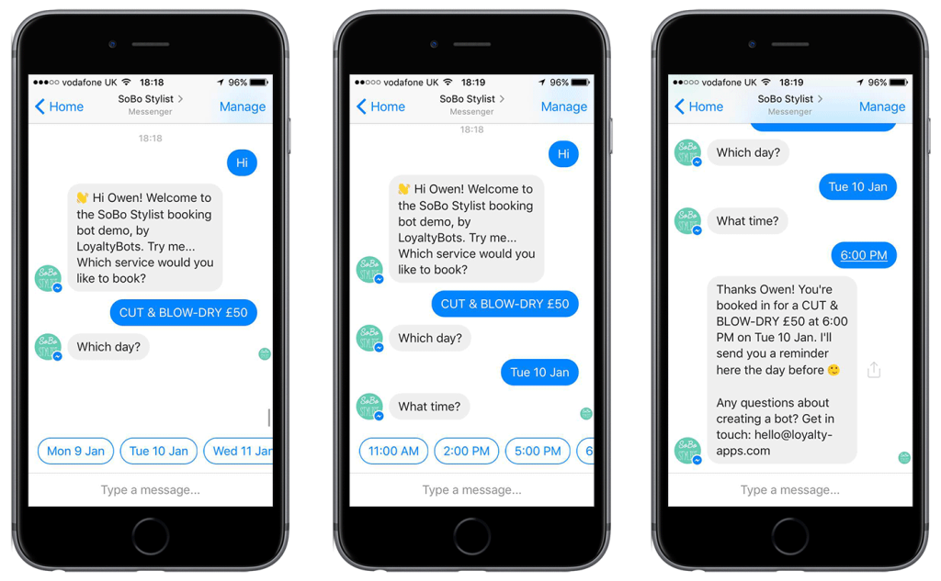
What Are Chatbots?

Slide 64
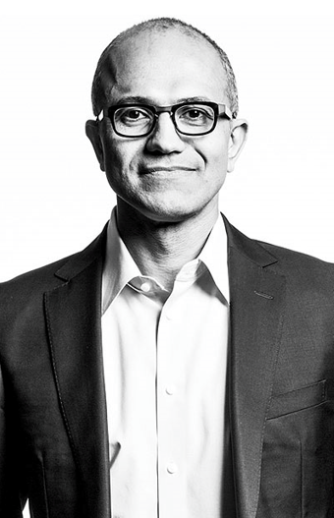
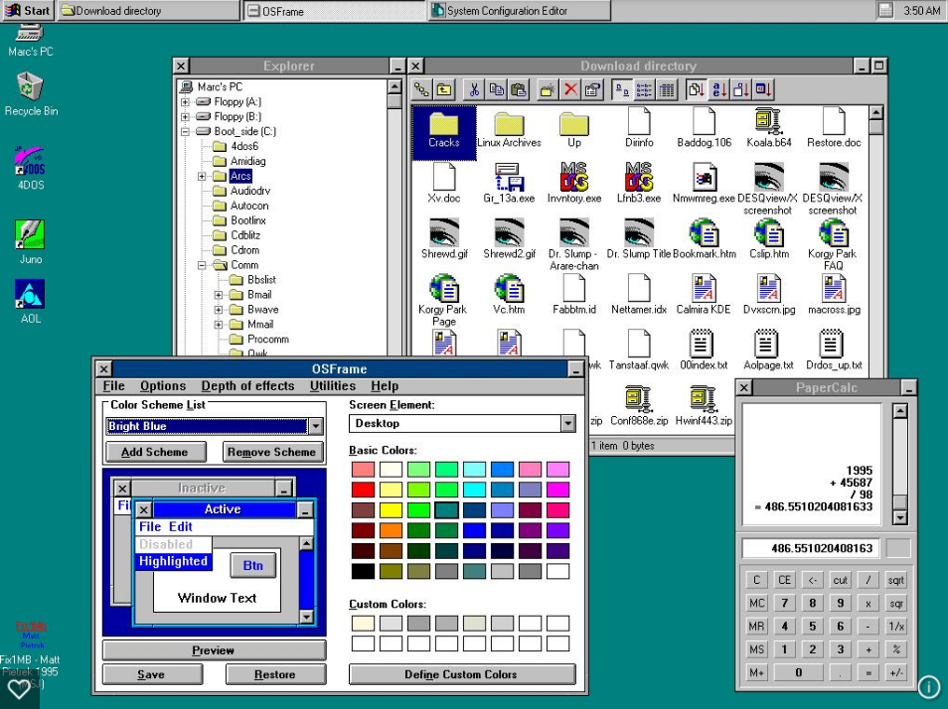
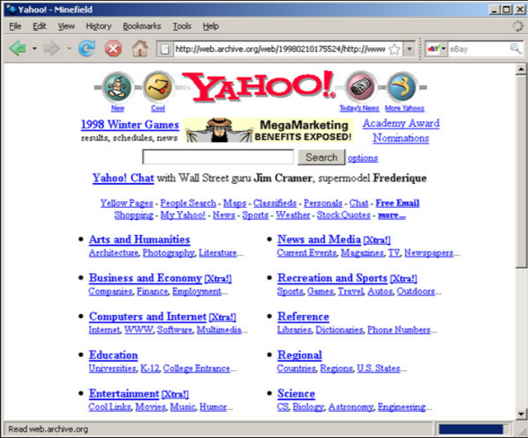
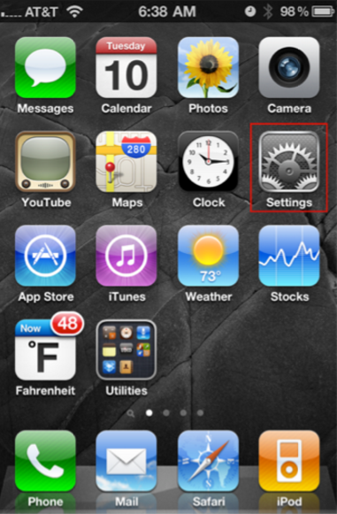
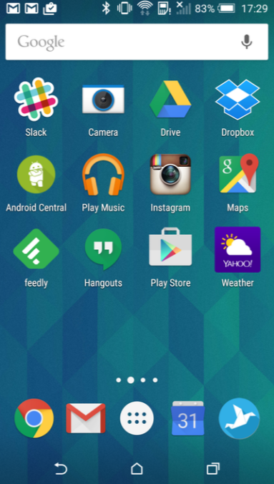

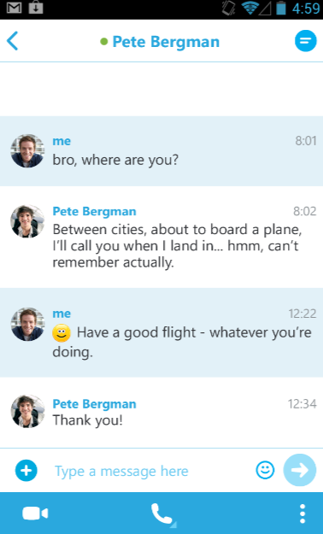
The world and technology are once again transforming
– Satya Nadella, CEO Microsoft
mid-80s
mid-90s
mid-00s
mid-10s
PC
Web
Smartphone
Messaging
Platform Examples
Desktop OS
Dos, Windows, Mac OS
Browser
Mosaic, Explorer, Netscape
Mobile OS
iOS, Android, WP
Messaging Apps
Whatsapp, WeChat, Skype
Application Examples
Programs
Excel, PPT, Lotus
Web Sites
Yahoo, Amazon
Apps
Angry Birds, Instagram
Bots / Agents
Weather, Travel
UI
GUI Apps
Web Pages
Native Apps
Conversations
Notes:
“The world and technology are once again transforming”
– Satya Nadella, CEO Microsoft
Use of Messaging apps surpassed Social apps in 2015
We want to take that power of human language and apply it more pervasively to all of the computing interface and the computing interactions through machine learning and AI.
CAAP:
Having the most natural enriched conversation with anyone -> Skype Translator (and other cognitive services)
Apply the same power of human conversation to everything else -> a personal digital assistant that know you and your world, and is always there to help you with your everyday tasks across all devices
Calling any application (as a bot) within a conversational canvas instead of looking at pages and pages of websites and apps
“And so you can conceptualize this platform where human language is the new UI layer. Bots are like new applications, and digital assistants are meta apps or like the new browsers. And intelligence is infused into all of your interactions. That’s the rich platform that we have.”
Articles:
https://chatbotbook.com/the-rise-of-intelligent-bots-e896cde7281b#.3xv2h6m48
https://chatbotsmagazine.com/chinas-wechat-foretells-facebook-microsoft-bot-platforms-future-278c3bd4bf14#.7jtideqdl
http://www.cnet.com/how-to/what-is-a-bot/#!
http://www.theverge.com/2016/3/30/11334000/microsoft-big-bots-bet
http://www.enterprise-security-today.com/news/Why-Should-We-Care-About-Bots-/story.xhtml?story_id=0110018ENHC3
http://www.marketplace.org/2016/04/11/tech/chat-bots

Slide 65
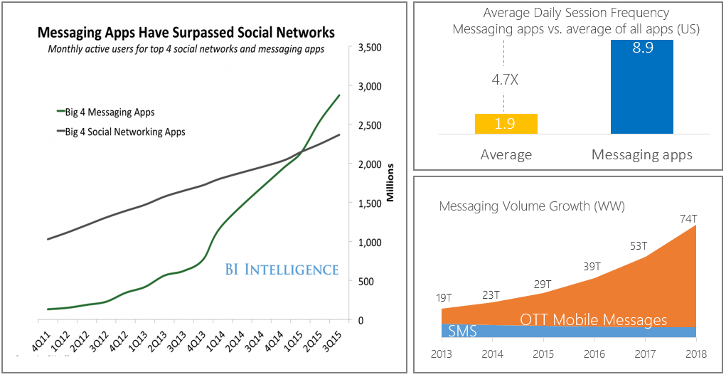
Conversations are the new platform of habit
Messaging apps experience explosive growth in terms of active users, frequency of use and messaging volume
Source: BI Intelligence, Portio Research

Slide 66










Worldwide: Size of chat networks
Messaging apps experience explosive growth in terms of active users, frequency of use and messaging volume
900M+ WW MAU
200M+ WW MAU
300M+ WW MAU
N/A
1B+ WW MAU
370M+ WW MAU
230M+ WW MAU
200M+ WW MAU
650M+ WW MAU
20M+ WW MAU
Source: Search Biz Planning & Strategy. Data from comScore. Does not include: SMS (est. 40% share), iMessage (iOS), Telegram (est. 100M+ WW MAU)

Slide 67
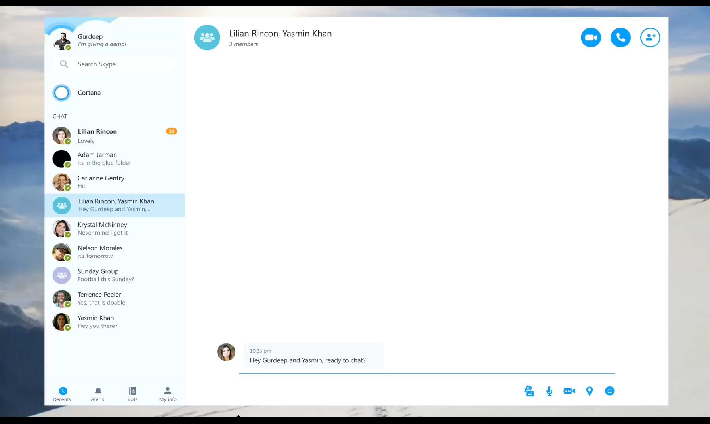
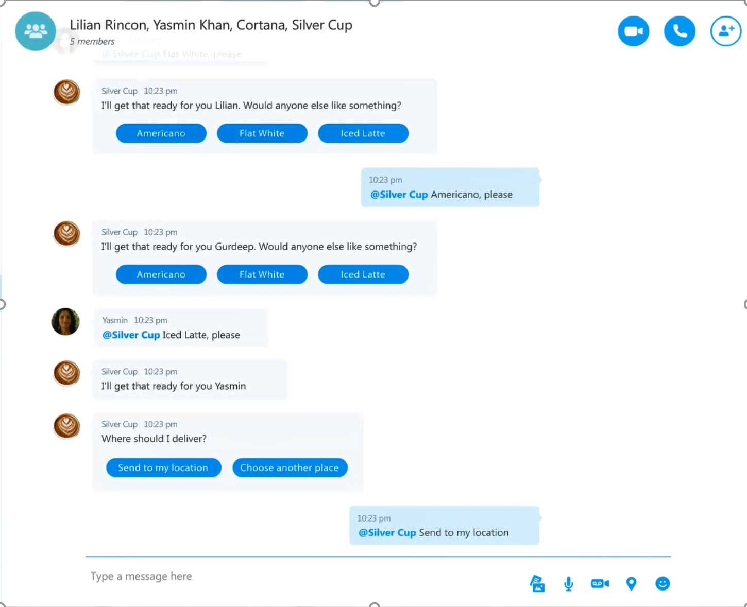
So really, why Bots and why now?
Reach customers anywhere, on any platform or device
Engage with customers in a natural way; conversationally and in context
Consumer and Enterprise business opportunities
The democratizing of AI and NLP technology
Notes:
Data and device price decline
Engaging chat + content + services
5x growth over next 3 years
Young demographic
Higher retention & usage than apps
Opportunity for 1:1 connection
Monthly users of messaging apps surpassed
Social apps a year ago

Slide 68
Examples of Bots

Slide 69
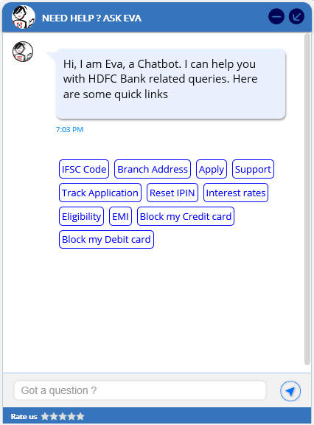
HDFC Bank Virtual Assistant

Slide 70
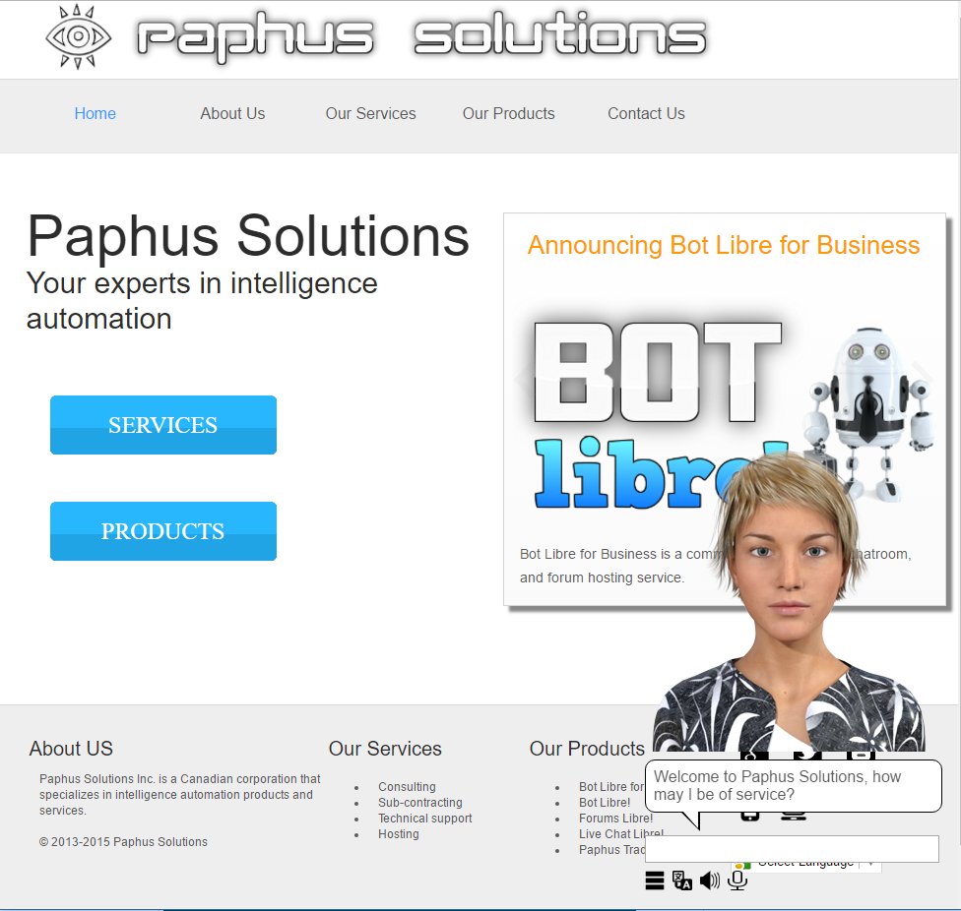
Paphus Solutions Voice Bot
http://www.paphussolutions.com/#

Slide 71
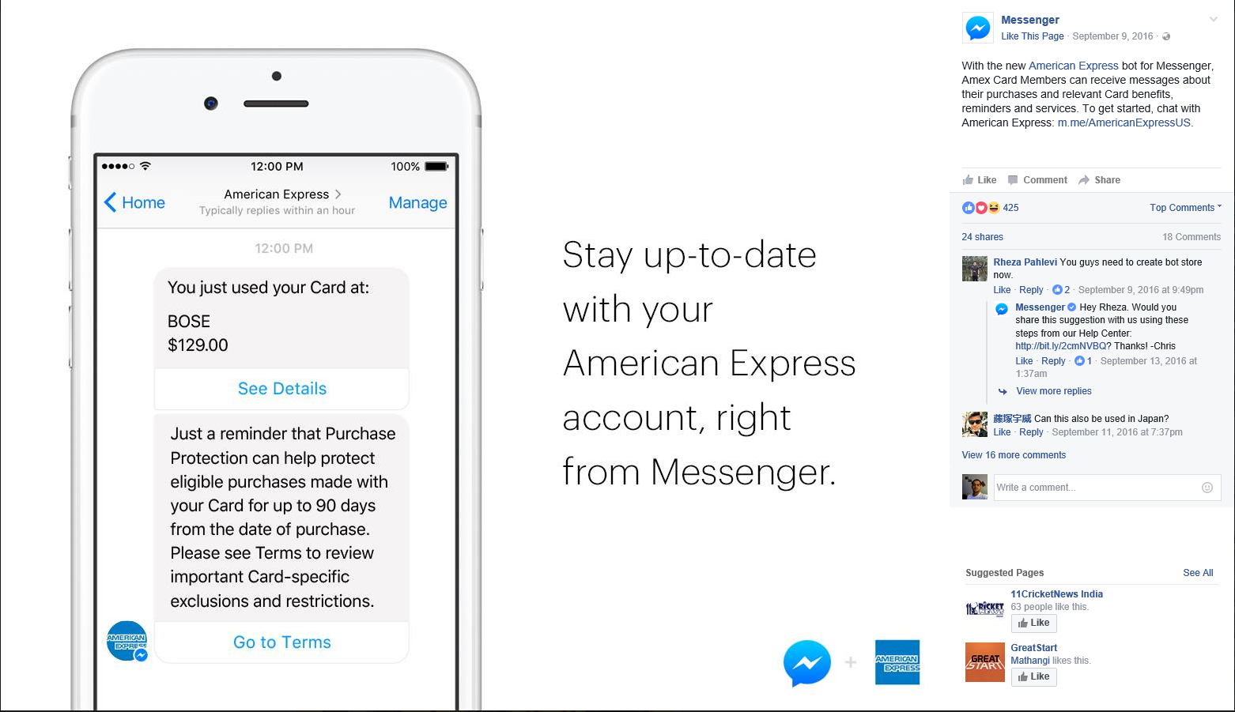
American Express Facebook Bot
https://www.messenger.com/t/AmericanExpressUS/

Slide 72
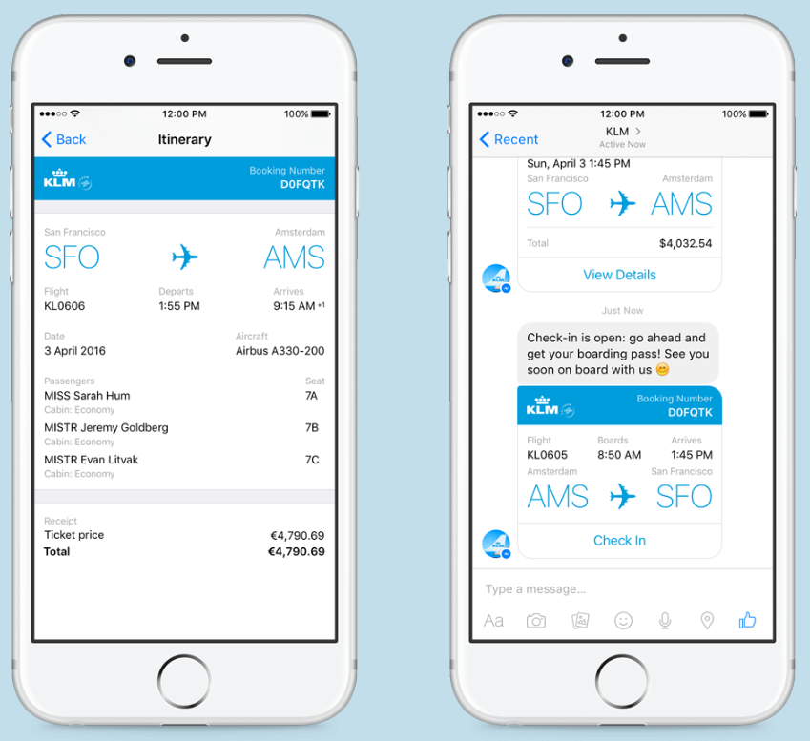
KLM Airlines Facebook Bot
https://messenger.klm.com/

Slide 73
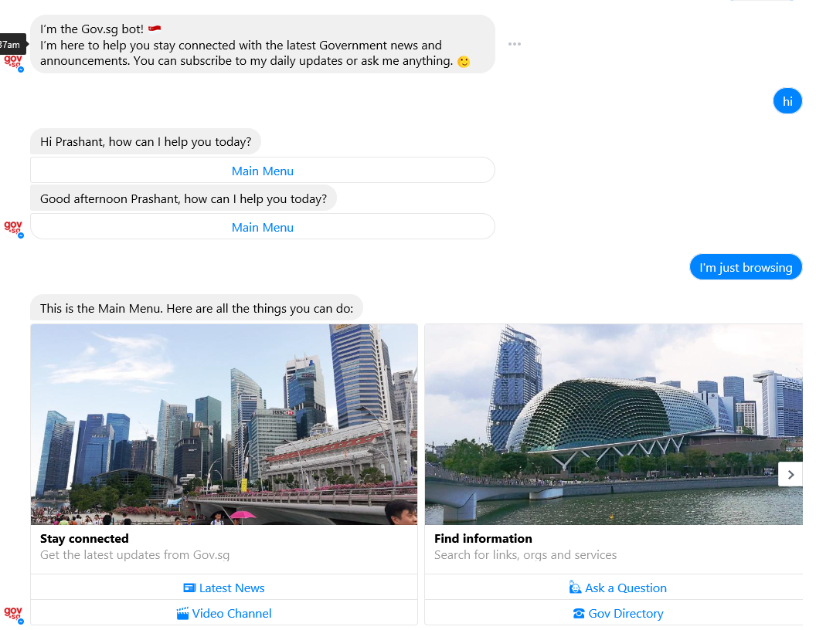
Singapore Govt. Bot
https://m.me/gov.sg

Slide 74
Chatbots
Popular ones:
Alexa, Siri, etc.
Microsoft is carrying out a massive social experiment in China - and almost no one knows about it
Xiaoice is used by millions of people every day, and can respond with human-like answers, questions, and "thoughts."
If a user sends a picture of a broken ankle, Xiaoice will reply with a question asking about how much pain the injury caused,
If it's something she doesn't know much about, she will try to cover it up.
If that doesn't work, she might become embarrassed or even angry, just like a human would.
Millions of Chinese users were telling Xiaoice that they loved it.
Around 25% of Xiaoice's users - 10 million people - had said "I love you" while using the service.

Slide 75
Classroom
To help with his class this spring, a Georgia Tech professor hired Jill Watson, a teaching assistant unlike any other in the world.
Throughout the semester, she answered questions online for students, relieving the professor’s overworked teaching staff.
But, in fact, Jill Watson was an artificial intelligence bot.
Ashok Goel, a computer science professor, did not reveal Watson’s true identity to students until after they’d turned in their final exams.
Students were amazed. “I feel like I am part of history because of Jill and this class!” wrote one in the class’s online forum.
“Just when I wanted to nominate Jill Watson as an outstanding TA in the CIOS survey!” said another.

Slide 76
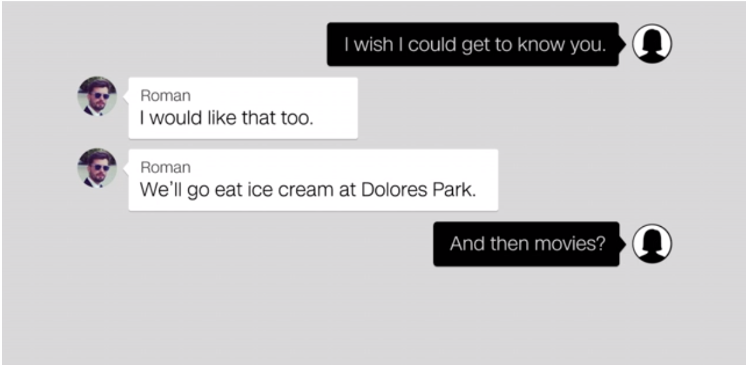
Luka

Slide 77
Examples of Chatbots on Skype

Slide 78
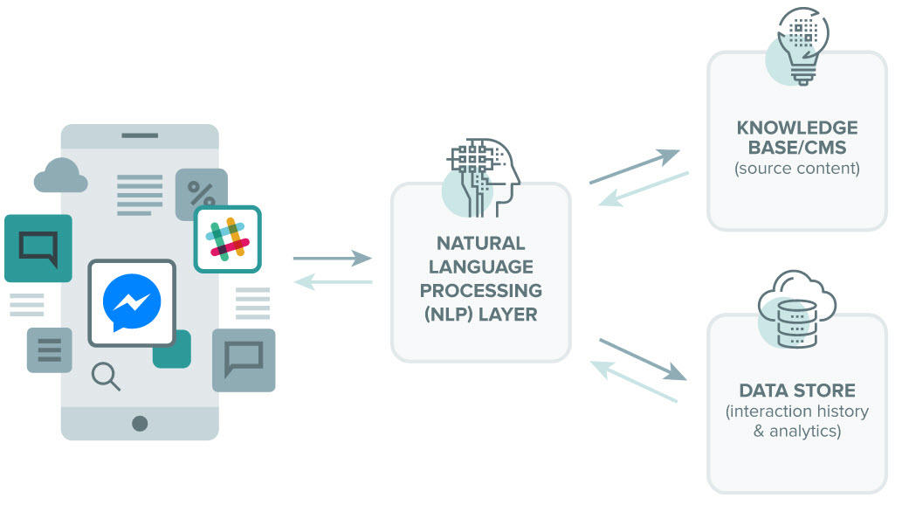
How Do Chatbots Work?

Slide 79
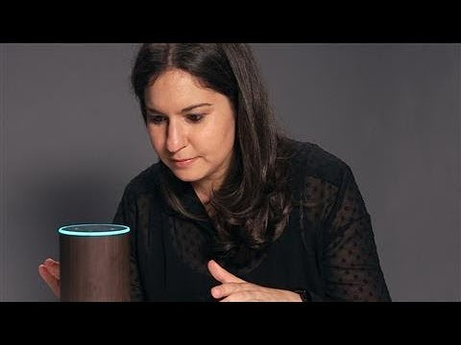
Teach Amazon Echo to Recognize Your Voice

Slide 80
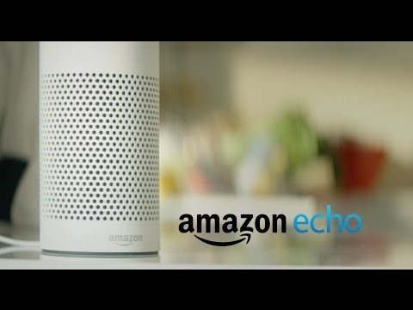
Voice Shopping with Alexa

Slide 81
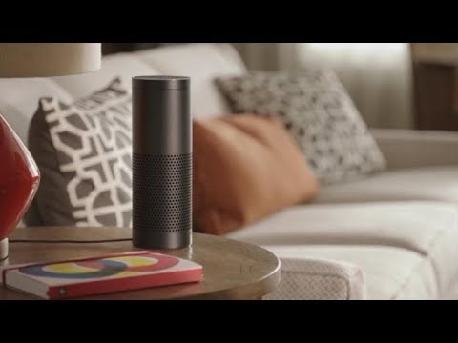
Potential Problems

Slide 82
Business Value of Chatbots

Slide 83
Recent Examples and Implementations
1-800 Flowers Leverages a Chatbot to improve customer experience
1-800-FLOWERS made ordering the perfect floral arrangement even easier by creating a Facebook Messenger chatbot to help customers order flowers.
The bot is trained to pick up on conversational cues to suggest arrangements
if a customer mentions they need something quickly, the bot can briskly suggest the perfect flowers to win someone over.
The bot shows pictures of each arrangement and makes it easy for customers to create their own message and set up the delivery

Slide 84
Recent Examples and Implementations
Retailer North Face Uses Watson to Create a Personalized Shopping Experience
North Face uses IBM’s AI supercomputer Watson to create a personalized online shopping experience.
The site helps customers refine product selections based on their answers to a series of questions.
If a customer says they like to hike in the winter, the program would ask questions about their location and preferences to recommend a jacket that will keep them warm and work with their preferred activities.
Instead of sorting through hundreds of products to find the right one, the bot makes the choice much easier.

Slide 85
Recent Examples and Implementations
Dixons Carphone Recommends Insurance Through A Chatbot
UK-based Dixons Carphone uses artificial intelligence in the form of a bot named Cami to connect online and in-store shopping experiences.
Cami is a product expert who can recommend items, give advice, and anticipate customer’s needs and future purchases.
If someone buys a new mobile device, Cami can automatically recommend cases or insurance.
Cami can also easily check inventory, so in-store associates can stay with the customers.
Employees can spend more time interacting with customers in the front of the store instead of sorting through inventory in the back of the store.

Slide 86
Recent Examples and Implementations
Customers Buy Domino’s Pizza Through Facebook Messenger
It’s never been easier to order a pizza, thanks to AI.
Domino’s uses a Facebook Messenger chatbot named Dom that allows customers to place an order simply by sending a message that says “pizza”.
The bot gets the details and the order is completed faster than a customer could call the store or drive to place an order.

Slide 87
Disruptions Through Autonomous Vehicles
Professor Subodha Kumar

Slide 88
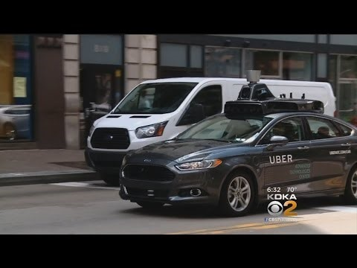
Uber Launch (September 2016)
Notes:
How

Slide 89

Arizona Accident (March 2018)
Notes:
How

Slide 90
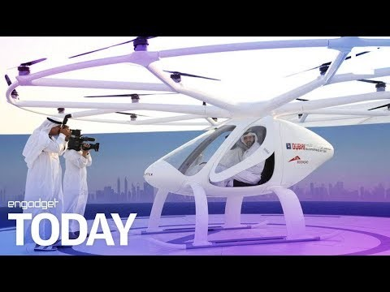
Flying Taxi
Notes:
How

Slide 91
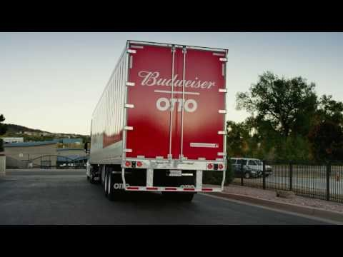
Driverless Truck
Notes:
How

Slide 92
IOT and Autonomous Vehicles
Impact on Supply Chain?
Notes:
How

Slide 93
Electric and Autonomous Vehicles
What is the reason for slow growth of electric vehicles?
Involvement of new players for developing technologies
Will it make the traditional carmakers commodity?
or will it stop traditional carmakers from being commodity?

Slide 94
Most Promising Features of Autonomous Vehicles
Single-lane Autopilot
Autonomous Breaking
Autoparking
…….
Most of the carmakers are targeting 2020
Is it achievable?

Slide 95
Policy and Operational Issues
Who is responsible?
Should all carmakers use same (or similar) operating systems
To make it easy to communicate
Is low cost of oil a challenge
Government regulations
Will car be like cellphones
What will be the role of ride-sharing players
Good or bad for carmakers?

Slide 96
Google Car

Slide 97

GM Car

Slide 98
Why don’t we trust driverless cars?
We trust algorithms from recommendation systems
Then, why not for cars?
We are less forgetful for mistakes of algorithms than those of human
We trust algorithms more when we have some opportunity to tweak the results
Contrary to what players like Google are offering

Slide 99
Adoption?
A 2013 survey found that 57% of consumers worldwide would trust a driverless car, although only 46% would allow their children to ride in them.
A 2012 survey found that 37% of vehicle owners would be willing to purchase a fully automated car, but that figure dropped to 20% when respondents learned that the technology would cost an additional $3,000.

Slide 100
Current State of Connected Cars
Not All Drivers Are Convinced
To function properly, autonomous and connected cars must communicate with other vehicles (V2V)
For example, roadside beacons that transmit information and guidance.
This makes cars vulnerable; the one aspect of connected cars that might attract future users of Internet-of-Things powered cars is the prospect of enhanced safety.
These vehicles will use IoT to help avoid accidents and control a wide array of on-board safety technologies.
Various secure in-vehicle protocols for controller area networks are being developed.

Slide 101
Electric Vehicles in India
In December 2017, SIAM (Society of Indian Automobile Manufacturers) came up with a white paper that stated electric vehicles will constitute 40 per cent for overall new car sales by 2030.
The apex carmakers' body had predicted a 100 per cent electric vehicle sales only by 2047.
Nitin Gadkari flaunted the idea of having electric vehicles to account for 100 per cent of all new sales by 2030.
Power and New and Renewable Energy Minister, R K Singh said the government will bring out a policy for electric vehicle charging infrastructure.
"The policy will provide that charging e-vehicles would be a service and not sale of electricity. Thus all those setting up charging stations would not require a licence," Singh added.
Power Secretary Ajay Kumar Bhalla has confirmed that the government is focusing on creating charging infrastructure and policy framework so that by 2030 more than 30 percent of vehicles are electric vehicles.
Power Minister further said that the policy for electric vehicle charging infrastructure should be a reality because its draft is finalized by the Central Electricity Authority and power ministry agrees on that in-principle.
The EV policy would provide norms for bidding, installation and power sale price of charging stations among others.
State-run Energy Efficiency Service Ltd (EESL) floated another tender for 10,000 electric cars in March 2018.
EESL had earlier floated a tender for procuring 10,000 electric cars for which Tata Motors and Mahindra & Mahindra qualified the bids under the auction.

Slide 102

Startups in India Working On Self Driving Technology

Slide 103
Startups in India Working On Self Driving Technology
Fisheyebox:
A tech startup based out of Kolkata
Hi Tech Robotic Systemz:
Gurgaon headquartered Hi Tech Robotic Systemz is taking driverless vehicles in India a notch higher
ATImotors:
Bangalore based startup
Netradyne:
Founded by Avneesh Agrawal, a former Qualcomm Inc. president for India and South Asia, and David Julian, a former principal engineer
Swaayatt Robots:
Founded by Sanjeev Sharma, an IIT Roorkee alumnus
Auro Robotics:
Run by IIT Kharagpur alumni
OmniPresent Robot:
India’s one of the leading robotics provider
SeDriCa 1.0 from IIT Bombay:
Autonomous ground vehicle by IIT Bombay’s Innovation Cell

Slide 104
What Happened?
March 9, 2018:
Just days after ride-hailing service Uber announced it was testing tractor-trailers that drive themselves, Google's autonomous vehicle operation announced similar testing in Georgia.
Waymo says that starting next week it will run self-driving rigs in the Atlanta area with human backup drivers. They'll travel freeways and local roads to deliver server racks and other cargo destined for Google's data centres.
Waymo is an autonomous car development company and subsidiary of Google's parent company, Alphabet Inc.
The Alphabet Inc. unit says the trucks will have the same technology and sensors as autonomous minivans that are being tested in the Phoenix area.
Waymo wouldn't say how many trucks are being tested, but it released pictures showing two blue semis.

Slide 105
Waymo’s Early Rider program
Recently, Waymo began inviting members of its Early Rider program in Phoenix to take trips in its fully driverless minivans.
These are normal people who signed up back in 2017 to serve as guinea pigs for the Google spinoff’s experiments in self-driving transportation.
They released videos on March 13, 2018 to display users’ experience.

Slide 106

Waymo’s Early Rider program

Slide 107

“Cora” Flying Taxi
March 13, 2018: Larry Page-backed firm unveils flying car called "Cora"

Slide 108

Boring Company Tunnel
December 19, 2018: Elon Musk unveiled his new Boring Company tunnel

Slide 109


Slide 110
Potential Impact on Parking
The average privately owned car in the U.S. is in use just 5% of the time and spends the rest of the time parked.
But that picture could change to the extent that autonomous vehicles roll into action.
If driverless cars really do put the pedal to the metal, one ramification of having a car zoom away as soon as you get to your destination could be a reduced need for parking lots
which are, of course, a form of commercial real estate, even if they typically don’t involve buildings.

Slide 111
Potential Impact on Labor Market
Trucking companies would not need drivers anymore
However, they would still need someone to monitor the logistics of their operations.
Skill sets required in the labor force will move from basic to advanced
Increasing demand for employees who are versed in higher-level operations, supply chain management, and technology skills.
Still, it is likely that many jobs will be eliminated and replaced by machines
Overall, society is moving to more functions performed by computers, algorithms, and now self-learning and self-deciding robots.
This challenges labor markets to produce the right talent and also to redistribute those displaced by automation.

Slide 112

Connected Cars

Slide 113

Connected Cars

Slide 114
Machine Learning and Artificial Intelligence
The most important general-purpose technology of our era is Artificial Intelligence (AI)
particularly machine learning (ML), i.e., the machine’s ability to keep improving its performance without humans having to explain exactly how to accomplish all the tasks it’s given.
ML has become far more effective and widely available. We can now build systems that learn how to perform tasks on their own.
ML helps humans articulate knowledge that lets them accomplish simple but fundamental tasks, such as
recognizing faces, making a smart move in chess, or recognizing numbers and text.
ML is great for automating learning and insights. It can help recognize minuscule details in large quantities of data, like finding a pin in a haystack.

Slide 115

Ecosystem

Slide 116
Difference between AI and ML
Artificial Intelligence
broader concept of machines being able to carry out tasks in a way that we would consider “smart”
Machine Learning
current application of AI based around the idea that we should really just be able to give machines access to data and let them learn for themselves

Slide 117
Early Days
AI has been around for a long time
Greek myths contain stories of mechanical men designed to mimic our own behavior.
Very early European computers were conceived as “logical machines” and by reproducing capabilities such as basic arithmetic and memory
engineers saw their job, fundamentally, as attempting to create mechanical brains.
As technology, and, importantly, our understanding of how our minds work, has progressed, our concept of what constitutes AI has changed.
Rather than increasingly complex calculations, work in the field of AI concentrated on mimicking human decision making processes and carrying out tasks in ever more human ways.

Slide 118
Applied vs. General AI
Applied AI
far more common
systems designed to intelligently trade stocks and shares, or maneuver an autonomous vehicle
Generalized AIs
systems or devices which can in theory handle any task
are less common, but this is where some of the most exciting advancements are happening today
It is also the area that has led to the development of Machine Learning
Often referred to as a subset of AI, it’s really more accurate to think of it as the current state-of-the-art

Slide 119
Rise of Machine Learning
Realization
credited to Arthur Samuel in 1959
rather than teaching computers everything they need to know about the world and how to carry out tasks, it might be possible to teach them to learn for themselves
Emergence of the internet
and the huge increase in the amount of digital information being generated, stored, and made available for analysis

Slide 120
What is the Machine Learning Process?
Convert Real world problem to a prediction task
Gather training data
Create Features
Train a model, tune parameters
Evaluate the model
A person will find job in Microsoft or not ?
Develop a binary classifier to predict
Details of folks who got selected for MS and who DID NOT make it
# years of job experience
previous companies
keywords in resume
Decision Trees
SVM
Random Forest
Neural Networks
Logistic Regression
Precision
Recall
AUC
Accuracy
F1

Slide 121
Neural Network
Computer system designed to work by classifying information in the same way a human brain does
It can be taught to recognize, for example, images, and classify them according to elements they contain.
Essentially it works on a system of probability
based on data fed to it, it is able to make statements, decisions or predictions with a degree of certainty.
The addition of a feedback loop enables “learning” – by sensing or being told whether its decisions are right or wrong, it modifies the approach it takes in the future.
ML applications can read text and work out whether the person who wrote it is making a complaint or offering congratulations
They can also listen to a piece of music, decide whether it is likely to make someone happy or sad, and find other pieces of music to match the mood.
In some cases, they can even compose their own music expressing the same themes.

Slide 122
Natural Language Processing (NLP)
Another field of AI
has become a source of hugely exciting innovation in recent years, and one which is heavily reliant on ML.
NLP applications attempt to understand natural human communication
either written or spoken, and communicate in return with us using similar, natural language.
ML is used to help machines understand the vast nuances in human language
and to learn to respond in a way that a particular audience is likely to comprehend.

Slide 123
ML Technology
Supervised learning
most heavily explored type of machine learning and the most common type found in commercial applications.
The supervised learning task is to learn some general function from a set of training examples of input-output pairs of the function.
For example, we might want to learn a function that takes as input an email message and outputs a binary label to classify whether the email is spam or not, training it by providing a large collection of emails with their correct labels.
Thousands of important problems fit this template including classifying which emails are spam and diagnosing which medical patients have which disease.
Important prediction problems also fit into this category
predicting which customers will purchase which products,
predicting tomorrow’s stock price from today’s, or
predicting which credit card transactions are likely to be fraudulent.

Slide 124
ML Technology
2. Reinforcement learning
Typically apply to some agent interacting with its world via a set of actions, where the function to be learned takes the current observed world state as input, and provides the recommended next action as output.
This is inherently a more difficult learning problem than supervised learning because the training signal is more indirect and results from multiple choices by the agent.
Nevertheless, it is important because it covers significant problems such as learning how to maximize customer satisfaction over multiple interactions,
learning how to structure a website to maximize profit resulting from multiple visits.
One notable recent use of reinforcement learning was in AlphaGo and AlphaGo Zero, the AI systems that defeated the top human Go players.
AlphaGo Zero trained itself using reinforcement learning and millions of games

Slide 125
ML Technology
3. Unsupervised learning
Unsupervised learning problems require no training labels, and involve approaches such as clustering the data, or finding its principle components to help the user explore the data without a specific, pre-specified target function to be learned.
For example,
it can be used to cluster customer records into groups of customers with similar demographics and/or behavior,
to help understand which distinct types of customers appear in the data, or
to discover different types of objects in images or videos.
While this type of learning is used frequently to explore data interactively, it has led to fewer routine commercial applications.

Slide 126
Methodologies Used
Data Science
Structured, Sequential
ML
Visualization
Supervised
Unsupervised
Regression
Classification
Simulations and Optimization
Linear, Trees (RF), Neural nets, SVM, KNN, GBM
Time series
MA, ARIMA, Regression on time
Logistic, Trees (RF), Neural nets, SVM, NB, KNN, GBM
Anamoly
Statistical analysis
MonteCarlo
Linear programming
Segmentation
K-means, Hierarchical, DB Scan
Feature engineering
PCA
Recommendations
Associations, Collaborative filtering
The science
Choosing the graph, choosing the mapping, axes
The art
Clarity, transparency
The tools

Slide 127
Recent Examples and Implementations
Ticketmaster Combats Fraud With Artificial Intelligence
Ticketmaster turned to artificial intelligence to combat ticket fraud, which was making the ticket buying experience negative for its customers.
The company built a bigger bot to fight scalper bots that buy tickets and sell them for higher rates.
Before tickets go on sale, customers must register on the site. The AI bot then analyzes every customer to make sure the people purchasing tickets are actually human.
It seems to be working, as fewer tickets are ending up listed on third-party sites.

Slide 128
Recent Examples and Implementations
Skiing Through A Personalized Customer Experience With Black Diamond Equipment
Avid skiers often buy their equipment online from e-commerce retailer Black Diamond Equipment.
The site uses artificial intelligence to provide personalized recommendations for each customer.
Instead of waiting until checkout to make suggestions, the AI technology predicts customers’ needs and actively makes product recommendations based on things like browsing history, past purchases, and weather conditions.
With the new system, purchases have increased and abandoned carts have decreased.

Slide 129
Recent Examples and Implementations
Spotify Uses Artificial Intelligence To Tailor Music According To Preference
Music streaming giant Spotify’s entire business is based on data, but it takes things to the next level with AI technology.
AI allows the site to store more customer data and access it to find trends and predict what music each customer will like.
Each week, every Spotify user gets a personalized “Discover Weekly” playlist with music handpicked for them using AI data.
The service has gotten rave reviews for its accuracy to customers’ moods and musical tastes.

Slide 130
Recent Examples and Implementations
China Merchant Bank Uses WeChat Messenger to Handle Millions of Customers
China Merchant Bank, one of the largest credit card companies in China, takes advantage of AI bots to interact with a huge number of customers.
The bank’s WeChat Messenger bot handles 1.5 to 2 million customer conversations each day, mostly about things like card balances and payments.
Customers can quickly get the information they need, and it saves the bank from hiring thousands of human employees to match the same volume of requests.

Slide 131
Recent Examples and Implementations
Google Photo Automatically Labels Photos Using Artificial Intelligence
Google Photo leverages AI to remove a tedious task from its customers.
It automatically labels photos as customers upload them.
Instead of the customer having to go through and label and organize each picture, Google’s AI technology tags photos based on people, location, date, and more, which makes it easy to search and find the perfect image.

Slide 132
Recent Examples and Implementations
KFC Uses Artificially Intelligent Facial Recognition Software To Predict Orders
KFC has partnered with Chinese search engine Baidu to create a restaurant that uses AI facial recognition software to infer what a customer might want to order.
The program collects data like gender, facial expressions, and other visual features to provide menu recommendations to customers.
It also saves previous orders, so return customers can get recommendations based on what they’ve ordered before.

Slide 133
Take-Aways: AI
In conclusion, artificial intelligence can make your customer experience better.
It’s about finding the right use case for your business and a technology that will consider what your customers’ need.
AI should make customers’ lives easier and better.
However, don’t simply release AI on customers to do it – AI should serve a purpose for your customers’ journey.

Slide 134
Managerial Issues
PREDICTION IS NOT THE SAME AS AUTOMATION
Prediction is an in­put to automation, but successful automation requires a variety of other tasks.
The anatomy of a task involves data, prediction, judgment and action in order to attain an outcome.
Machine learning is only one component of this (prediction).
For exam­ple, medical care tasks include imaging (data), diagnostics (pre­diction), treatment choice (judgment), bedside manner (judge­ment/action) and physical intervention (action), among others.
Prediction is the stage of automation in which the technology is currently improving particularly rapidly, although advances in sensor technology (data) and robotics (action) are also advanc­ing quickly.

Slide 135
Managerial Issues
2. THE MOST VALUABLE WORKFORCE SKILLS INVOLVE JUDGMENT
For many activities, prediction was the bottleneck to automation.
This meant a role for human workers in aiding a variety of prediction tasks, including pick-and-place and driving.
Going forward, this role will diminish. Instead, employers will look for workers who augment the value of prediction.
Those related to judgment.
We can only speculate on the aspects of judgment that will be most valuable, but ethical judgement, emotional intelligence, ar­tistic ability and task definition will likely top the list.
This diverse group of skills suggests that the set of activi­ties in which the human role may increase in value is potentially wide-ranging:
nursing skills related to physical intervention and emotional comfort may become even more valuable if predic­tion leads to better diagnosis of disease;
retail store greeters may become increasingly effective if social interactions help differ­entiate stores in the presence of reliable predictions on purchase behaviour; and
security guarding skills related to ethical judge­ment and use of force may be of increased value as a comple­ment to the better prediction of crime.

Slide 136
Managerial Issues
3. MANAGING WILL REQUIRE A NEW SET OF TALENTS AND EXPERTISE
Managing a workforce whose skills are complementary to prediction may be quite different from managing a workforce for which a core skill is prediction.
For example, promotion can­not be based on the (often well-measured) success of past pre­dictions. Instead, alternative metrics must be developed.
Perhaps most important, managing a firm with AI capabili­ties will involve managing the artificial intelligence itself.
What are the opportunities for prediction?
What should be predicted?
How should the artificial intelligence agent learn to improve those predictions over time?
Managing in this context will re­quire judgment in identifying and applying the most useful predictions and weighing the relative costs of different types of errors.

Slide 137
Industry 4.0
Industry 4.0 is a name given to the current trend of automation and data exchange in manufacturing technologies.
It includes cyber-physical systems
Internet of things,
cloud computing, and
cognitive computing.
Industry 4.0 is commonly referred to as the fourth industrial revolution.

Slide 138
Industry 4.0
Driven by four disruptions:
the astonishing rise in data volumes, computational power, and connectivity, especially new low-power wide-area networks;
the emergence of analytics and business-intelligence capabilities;
new forms of human-machine interaction such as touch interfaces and augmented-reality systems; and
improvements in transferring digital instructions to the physical world, such as advanced robotics and 3-D printing.
The four trends are not the reason for the “4.0,” however.
Rather, this is the fourth major upheaval in modern manufacturing, following the
lean revolution of the 1970s,
the outsourcing phenomenon of the 1990s, and
the automation that took off in the 2000s.

Slide 139

Industry 4.0

Slide 140
Industry 4.0
Industry 4.0 fosters what has been called a "smart factory."
Within modular structured smart factories,
cyber-physical systems monitor physical processes,
create a virtual copy of the physical world, and
make decentralized decisions.
Over IoT,
cyber-physical systems communicate and cooperate with each other and with humans
in real-time both internally and across organizational services offered and used by participants of the value chain.
Insightzz

Slide 141
Industry 4.0
Manufacturing companies are not consistently aware of the emerging technologies.
In a recent survey of 300 manufacturing leaders; only 48 percent of manufacturers consider themselves ready for Industry 4.0.
Seventy-eight percent of suppliers say they are prepared.

Slide 142
Examples of different disruptive trends
Big data
An African gold mine found ways to capture more data from its sensors.
New data showed some unsuspected fluctuations in oxygen levels during leaching, a key process.
Fixing this, increased yield by 3.7 percent, worth up to $20 million annually.

Slide 143
Examples of different disruptive trends
Advanced analytics
Stronger analysis can dramatically improve product development.
One automaker uses data from its online configurator together with purchasing data to identify options that customers are willing to pay a premium for.
With this knowledge, it reduced the options on one model to just 13,000—three orders of magnitude fewer than its competitor, which offered 27,000,000.
Development time and production costs fell dramatically; most companies can improve gross margin by 30 percent within 24 months.

Slide 144
Examples of different disruptive trends in manufacturing
Human-machine interfaces
Logistics company Knapp AG developed a picking technology using augmented reality.
Pickers wear a headset that presents vital information on a see-through display, helping them locate items more quickly and precisely.
And with both hands free, they can build stronger and more efficient pallets, with fragile items safeguarded.
An integrated camera captures serial and lot ID numbers for real-time stock tracking.
Error rates are down by 40 percent, among many other benefits.

Slide 145
Additive Manufacturing / 3-D Printing
Additive Manufacturing (AM) is a manufacturing process that deposits materials layer-by-layer to build a tangible product.
The most common, and the most popular currently, is 3D printing.
AM is claimed to have triggered a industrial revolution
because the technology presents new and expanding technical, economical and social impacts.
Particularly, the increased accessibility to 3D printing capabilities has allowed mass customization to become more widespread in industries such as healthcare and consumer markets.

Slide 146

Additive Manufacturing / 3-D Printing

Slide 147

Additive Manufacturing / 3-D Printing

Slide 148

Additive Manufacturing / 3-D Printing

Slide 149

Additive Manufacturing / 3-D Printing

Slide 150

Additive Manufacturing / 3-D Printing

Slide 151

Additive Manufacturing / 3-D Printing

Slide 152
Additive Manufacturing / 3-D Printing

Slide 153
Aerospace Industry
Despite current limitations, particularly with materials and structural integrity, aerospace companies are exploring 3D printing for manufacturing various parts of their products.
Boeing has already used the technology to manufacture interior pieces of airplanes
NASA has used it to build rocket engines and parts for satellites.
In 2013, Airbus announced plans for an airplane that will include 3D-printed components that are significantly lighter but as strong as traditional machined parts

Slide 154
Heath Industry
There are already more than half a million 3D-printed dental implants in patients worldwide.
Various organizations are researching the possibility of bioprinting live cells and tissue
such as the University of Toronto’s Bio Printer project which is exploring the use of 3D-printed tissue for the treatment of burned patients.
3D printing also allows the production of complex shapes (such as hollow figures) and lightweight parts that can be used to create implants
a growing demand in countries with aging populations.
Another possible application is to create models of human parts from CT scans or MRI images to assist surgeons during complex surgeries.

Slide 155
Heath Industry
The path towards commercialization of these technologies is complex, long and expensive.
One of the key restraints of 3D printing in the health sector is certification of medical implants, a process that can take years and varies according to geographical location (making scaling more complex).
Furthermore, some applications require solid streams of funding to develop.
Organovo, the world’s most popular bioprinting company doubled revenue to $1.2 million from 2010 to 2012, but its losses increased nearly eight-fold to $9.3 million in the same time period.
University of Toronto’s Bio printer project could take between 5 to 7 years to actually reach patients.
New 3D printing project aims to bring relief to arthritis sufferers
https://www.irishtimes.com/business/innovation/new-3d-printing-project-aims-to-bring-relief-to-arthritis-sufferers-1.3604584

Slide 156
Consumers Market
Various reports predict that 3D printing will experience the biggest growth in the consumer market
However, the definitive consolidation of the consumer sector depends, among other things, on the irruption of a compelling application that would prompt consumers to embrace the technology
a “killer app” that, in connection with reduced prices, will finally bring the era of self-production into consumer homes.
These range from new lower-cost printers like a 3D printer that costs $100, catalogues of 3D models, computer-aided design (CAD) software, and customized design services.
Currently, 3D printers cannot compete with economies of scale or the mass production of some goods.
it is still unclear how 3D printing will affect consumer goods manufacturing.

Slide 157
Future
Research not only includes 3D printers and its applications, but also the materials.
3D printing may change how things are manufactured in the future but cannot replace mass manufacturing, at least not yet.
Universities are also exploring the technology, either as academic research projects or in a makerspace fashion.
Many universities are committed to research within the 3D printing and AM space, most of which have focused on healthcare or biomedical applications (such as prosthetics).
For example, a group of professors at McGill University are using 3D printers to create exact replicas of bones for spinal grafts.
Heal.X from OCAD University has developed a new form of casts/splints for broken bones created using 3D printing. These new casts are affordable, waterproof and can be fully customized.

Slide 158

3-D printed homes

Slide 159

3-D printing

Slide 160
Why is it important for each business to be aware of emerging technologies
To be competitive
If things go wrong, you will be held responsible
Enron Example
World is being more connected
You need to leverage that
IoT, e.g., car app
New business opportunities

